Slide 1

Vrije Universiteit Amsterdam
THESIS DEFENSE
Presented by M’hamed Belalia

Slide 2


ABSTRACT
Neuroevolution algorithms face computational bottlenecks with 70%+ of time spent on repetitive neural network evaluations. This research implements generational caching using LRU eviction to store neural computation results across NEAT generations.
01

Slide 3
OVERVIEW
01
Introduction
05
Objective
09
Result
02
Problem
06
Hypothesis
Conclusion
10
03
Theoretical
07
11
Recommendation
Design
04
Objective
08
Implementation
02

Slide 4

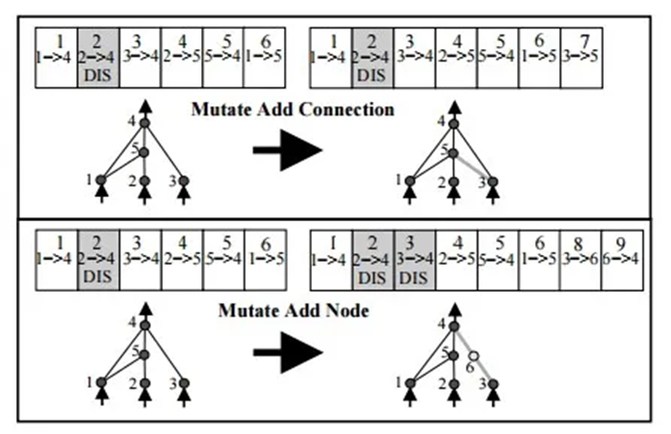
INTRODUCTION
NeuroEvolution : evolves both network topology and weight simultaneously
No need for labeled data or differentiable functions
Neat algorithm: starts minimal, grows complexity naturally
Proven success in games, robotics and control systems
Traditional ML: fixed architectures trained with gradient descent
Requires Labeled Data and differentiable functions
Limited to predefined Network structures
03

Slide 5
PROBLEM
1
2
3
Computational bottleneck 70%+ of time spent on neural network evaluations
Massive scale : Millions of neural computations per experiment (500 * 50 generation * thousands of evaluations
Repetitive Waste Identical neural computations repeated across generations
04

Slide 6
THEORETICAL
Temporal Localitity : Recently accessed data likely to be accessed again
Spacial locality: similar computations cluster together
LRU Principle Least Recently Used items are least likely to be needed
Cache
Neuroevolution caching
Generational Similarity: Networks share common substructures across generations
Computation Reuse: Identical/similar neurons calculations repeat frequently
Progressive Learning : Cache effectiveness improves over evolutionary time
Precision vs Diversity Trade-off: too precise = few hits, too coarse = reduced evolution
Cache size optimization: Balance between memory and effectiveness
Evolutionary Preservation: Caching must not compromise genetic diversity
Insight
05

Slide 7
OBJECTIVES
Objective 1
Objective 2
Design and Implement Generational Caching System
Develop a persistent caching mechanism that stores neural computation results across NEAT generations using LRU eviction strategy. The system must cache individual neuron computations rather than just network outputs, with precision-controlled cache keys to balance hit rates with genetic diversity preservation.
Validate Performance Improvement While Maintaining Solution Quality
Experimentally demonstrate computational speedup through controlled comparison on Atari Breakout benchmark. Measure cache hit rates, computation time reduction, and memory overhead while ensuring no degradation in evolutionary effectiveness or final solution fitness scores.
06

Slide 8

HYPOTHESIS
Implementing generational caching with LRU eviction strategy can accelerate neuroevolution by 5-10% without compromising solution quality. The cache will demonstrate progressive learning across generations, achieving hit rates of 20-30% while maintaining genetic diversity through precision-controlled quantization. Memory overhead will remain negligible (~3-5MB) compared to computational savings, making this approach practically viable for neuroevolution research.
07

Slide 9
Design
Architecture
Overall design
Generational Caching:
OrderedDict-based LRU cache with 50k to 150k
Persistent storegare across NEAT generations
Individual neuron computations caching(not just network output)
Fast Interger Hashing for O(1) cache operation
Cache Management:
Growth phase: Cache expands
Trimming phase: LRU eviction between generations to target size
Precision control: fp16 quantization with -5 to 5 clipping and 0.05 resolution
Conditional caching: Skip computations unlikely to benefit
Controled Comparaison:
Baseline: Standard NEAT without caching
Treatment: NEAT with generational caching
Environement: Atari Breakout
Metrics: Computation time, cache performance, fitness etc..
Methodology:
Mutilple cache size(50k,100k,150k) for optimization
50 generations per experiment for statistical significance
Same parameters across all configuration.
08

Slide 10
RESULT
Generation: | 50k cache | 100k cache | 150k cache | No cache
1 | 79.246 | 78.483 | 78.65 | 80.283
10 | 881.649 | 851.423 | 882.12 | 906.991
20 | 1805.52 | 1775.133 | 1816.095 | 1914.248
30 | 2803.058 | 2743.003 | 2846.935 | 2996.947
40 | 3854.866 | 3793.302 | 3932.984 | 4118.136
50 | 4945.414 | 4890.929 | 5,063 | 5265.959
Configuration | Total Time (50 gens) | Time Saved | Speedup | Improvement
100K Cache | 4890.929s (81.5 min) | 375.0s | 1.077× | 7.1% faster
50K Cache | 4945.414s (82.4 min) | 320.5s | 1.065× | 6.1% faster
No Cache | 5265.959s (87.8 min) | 0s | 1.0× | 0% (baseline)
9

Slide 11
RESULT
Generation: | Best 50K | Worst with no cache | Best with no cache | Worst with 100k | Best with 100k
50 | 1092.6034 | 240.039 | 244.7916 | 182.2436 | 191.8926
Metric | 100K Cache | No Cache | Difference
Total Nodes | 6 | 5 | +1 (+20%)
Total Connections | 444 | 397 | +47 (+12%)
Hidden Nodes | 2 | 1 | +1 (+100%)
Network Layers | 3 | 2 | +1 (+50%)
Generation | 100k cache total connection | total connection no cache
50 | 444 | 397
Insight:
High variability typical of evolutionary algorithm across all configurations
50k cache breakthrough: Achieved high performance with fitness of 1092.6 showing cache doesn’t limit potential
Consistent performance: most runs converged to similar fitness ranges (180-250)
No systematic degradation: Caching doesn’t change much solution quality
Network complexity preserved :Caching enabled evolution of more sophisticated architectures (6 nodes, 3 layers vs 5 nodes, 2 layers) with 12% more connections, demonstrating that speedup doesn't compromise structural exploration
10

Slide 12
CONCLUSION
Main Findings:
Hypothesis Validated: Achieved 7.1% performance improvement, falling within predicted 5-10% range
Speed Without Sacrifice: Reduced computation time from 87.8 to 81.5 minutes while preserving solution quality
Enhanced Evolution: Caching enabled more complex network architectures (6 nodes, 444 connections vs 5 nodes, 397 connections)
11

Slide 13
RECOMMENDATION
1
2
Expand Research Scope:
Apply generational caching to different NEAT applications beyond Atari games, testing on robotics , real-time strategy games, and neural architecture search problems with longer experiments (100+ generations) to validate performance across diverse domains. Additionally, conduct multiple independent runs with statistical analysis and test with varying population sizes (100-500 genomes) to establish more robust performance baselines and scaling characteristics.
Develop Better caching system:
Implement faster hash functions and fuzzy matching within tolerance ranges to reduce lookup time and cache misses, while adding predictive prefetching based on network evolution patterns. These optimizations could potentially increase the current 7.1% speedup to 10-15% performance improvement.
12

Slide 14

THANK
YOU
Presented by M’hamed Belalia
Vrije Universiteit Amsterdam

